Slide 1


Slide 2




Breast Cancer Risk Prediction
“In the realm of healthcare advancement, this project focusses on the strategic refinement of prediction algorithms utilizing machine learning techniques. By sharpening our focus on Breast Cancer Risk prediction, we aim to pioneer advancements that will redefine the early intervention strategies and contribute to the overall improvement of the patient health outcomes.”
Presented By :Shruti Singh

Slide 3
Introduction
Data Gathering /Data Refinement
01
Reason / Issues causing breast cancer Diseases and early detection bring essential benefits.
02
Comprehensive Dataset Overview
Refinement and Data Preparation Steps
EXPLORATORY DATA ANALYSIS
Feature Extraction
03
04
Find patterns and identify trends
Divide Features into X and Y
Gain valuable insights from the dataset
Machine Learning / Deep learning
Methodology
06
Experimental results
05
Algorithms or Models Used
Visuals of Compared models
Compare each Evaluate Algorithm
Accuracy, confusion matrix of models
Conclusion
Appendices and references
07
08
Importance of the used approach
Suggestion for future
Links and codes used in the project

Slide 4
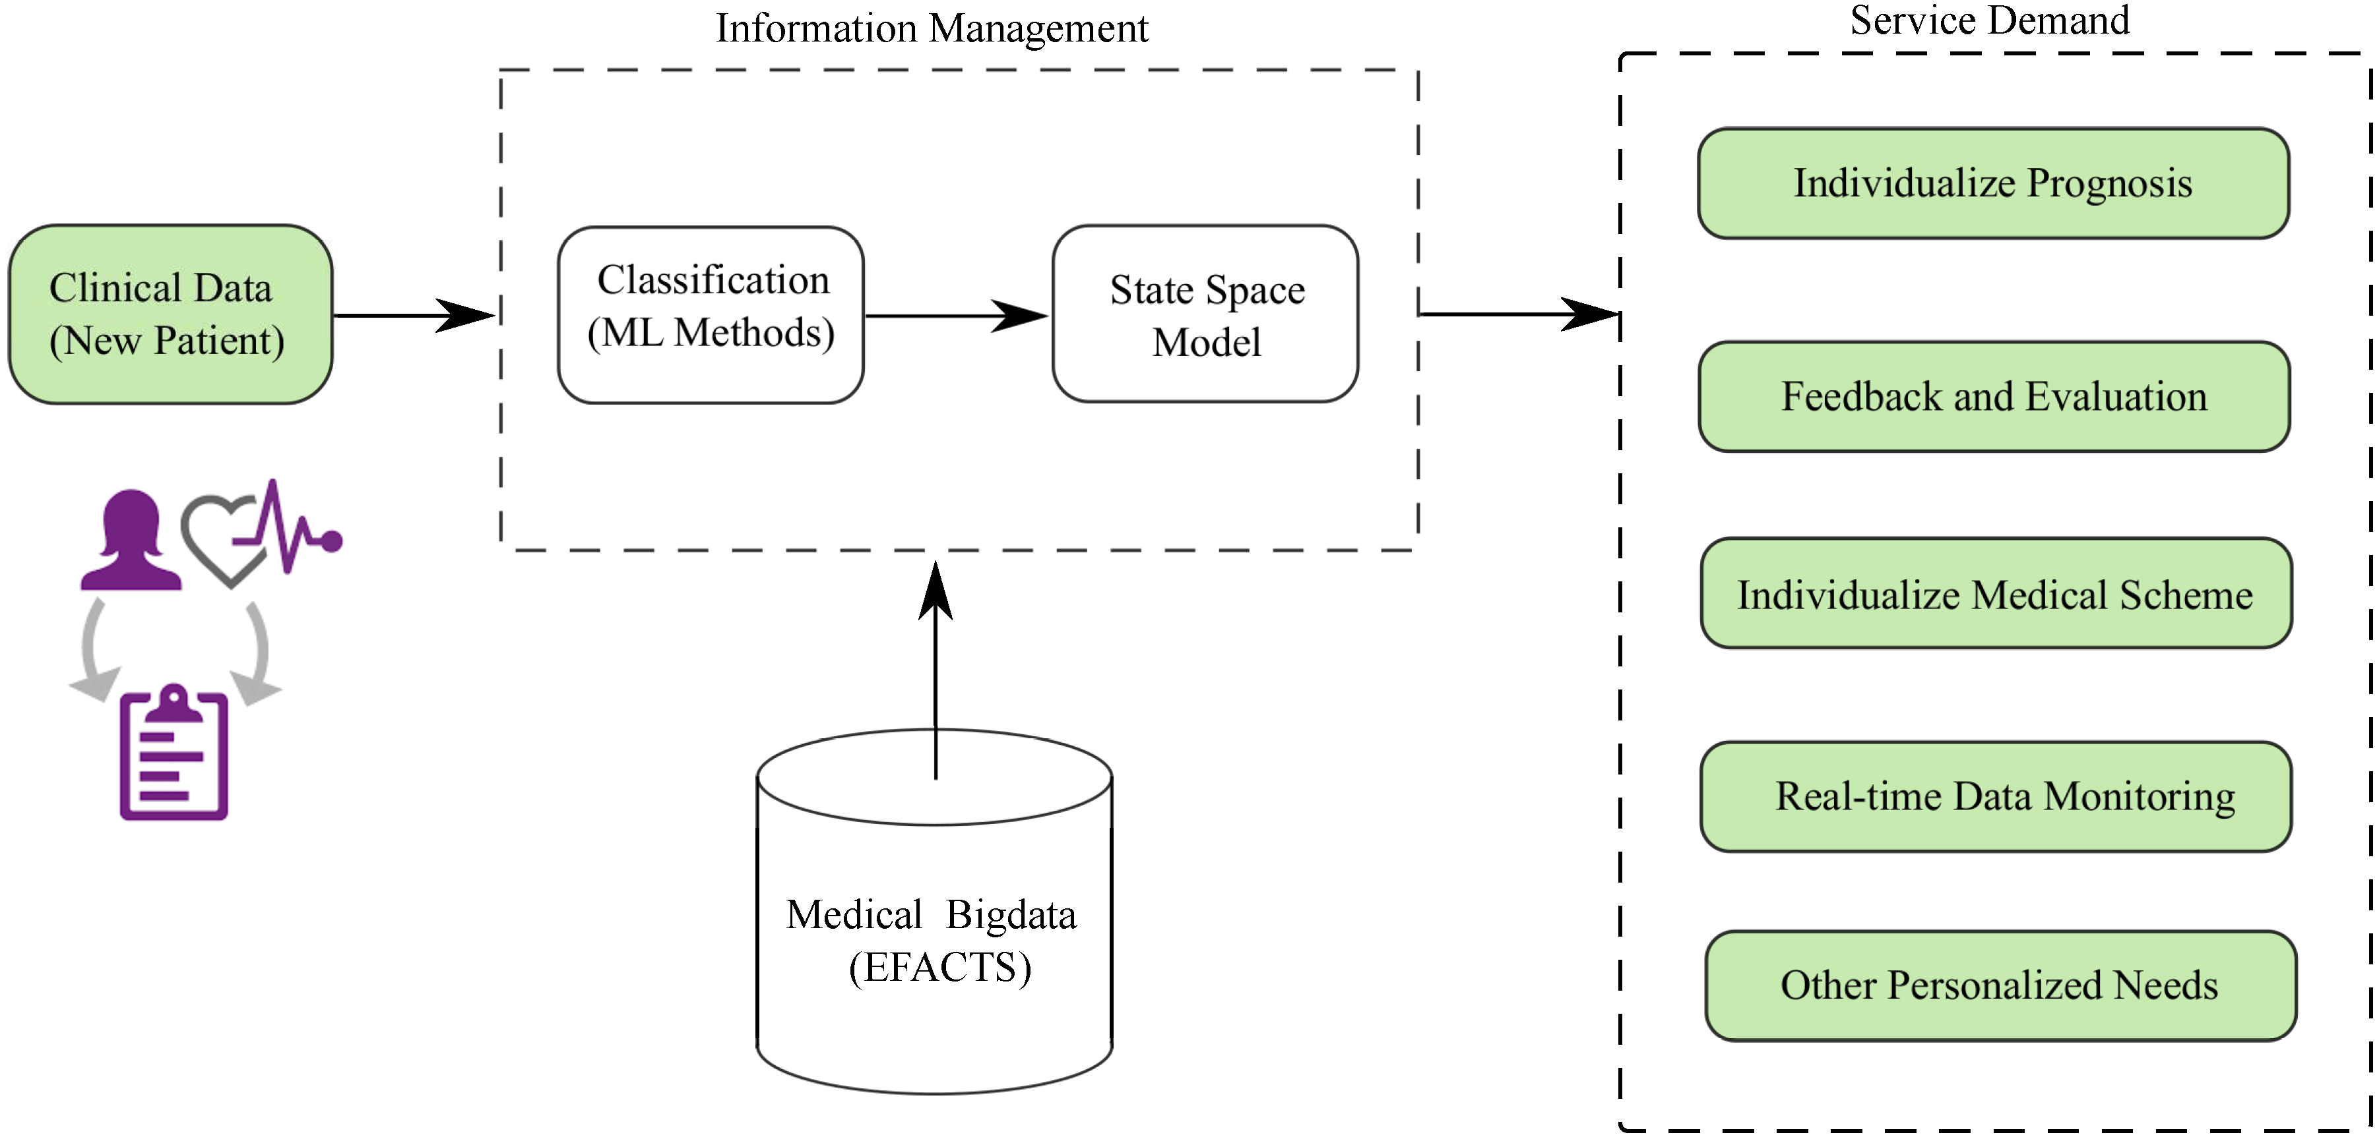

INTRODUCTION
Smoking
Hypertension
Breast cancer is considered a multifactorial disease and the most common cancer in women worldwide with approximately 30% of all female cancers(i.e. 1.5 million women are diagnosed with breast cancer each year, and 500,000 women die from this disease in the world). Over the past 30 years, this disease has increased, while the death rate has decreased. However, the reduction in mortality due to mammography screening is estimated at 20% and improvement in cancer treatment is estimated at 60%.
This dataset forms a comprehensive exploration of patient health indicators within a medical context, specifically focusing on factors related to Breast Cancer.
The datasets encompass 34 vital features such as Age at Diagnosis, Chemotherapy: Indicates whether the patient received chemotherapy (Yes/No), tumor size, tumor stage, cellularity and more.
The target variable, ‘10_year_mortality' signifies the likelihood of an individual surviving the cancer for the next 10 years i.e mortality risk.
Obesity
Sedentary lifestyle
Hyperlipidaem
Alcohol
33%
Fatalities Caused By CVD (each year)
Global Death

Slide 5






Objective OF The Study
Risk Stratification
Comparing Algorithms
Real - time Monitoring
Value Of The Study
Early detection and Prevention
Improved Patient Outcomes
Public Health Advancement

Slide 6


Monitor and Update
STEP
Continuously monitor the model's performance in the real-world scenario
07
Model Evaluation
STEP
06
Assessing the performance of a machine learning model using metrics
Model Selection and
Model Training
STEP
Choosing a suitable machine learning algorithm and optimizing its parameters
05
Split Train And Test Data
WORK FLOW
WORK FLOW
STEP
04
Dividing the dataset into training and testing sets to evaluate
PREPROCESSING
STEP
Preparing and cleaning data to enhance its quality and suitability
03
Exploratory Data Analysis
STEP
02
Analyzing and visualizing data patterns to understand its characteristics
Data Collection
STEP
Gathering and organizing data to train machine learning models.
01

Slide 7
Data Collection & Refinement
2509
**Variable | Description**
age | Age of the patient in years
sex | Gender of the patient (0 = male, 1 = female)
tumor_size | Tumor size in millimeters
stage | Cancer stage classification (0-4)
lymph_nodes | Number of positive lymph nodes
her2_status | HER2 receptor status (0 = negative, 1 = positive)
ER_status | Estrogen receptor status (0 = negative, 1 = positive)
PR_status | Progesterone receptor status (0 = negative, 1 = positive)
genetic_mutations | Number of known genetic mutations
treatment_type | Type of treatment (e.g., Chemotherapy, Radiotherapy, Hormone Therapy)
survival_time | Time in months from diagnosis to last follow-up or death
recurrence | Cancer recurrence status (0 = no recurrence, 1 = recurrence)
nottingham_prognostic_index | Prognostic index used for survival prediction
target | 10-year mortality risk (0 = Living, 1 = Deceased)
Breast Cancer Risk Prediction
34
ROWS
breast_cancer_df
COLUMNS
Features
(Columns)
Age At Diagnosis
Demographic Information
X
Sex
Clinical Data
Cellularity,Pam50+Claudin-low subtype, ER Status, Neoplasm Histologic Grade,HER2 status,Hormone Therapy
10 year Mortality
0:Living
Y
Outcome Variable
1-Deceased

Slide 8

EXPLORATORY DATA ANALYSIS
Exploratory Data Analysis (EDA) helped us understand the data structure, find patterns, identify trends, and gain valuable insights from the dataset.
From EDA we analyze, the distribution of each features, checking the correlation between the features .
Using visuals helped us see the data clearly, understand the clinical data relationship with each other, and pinpoint factors that plays vital role in predictions of 10 year mortality .
The datasets is clean ,as there is no NULL VALUE, but we can find some DUPLICATE VALUES and OUTLIERS.
We looked at our data columns and found 9 columns to be numerical in terms of data types, but they are categorical in terms of semantic. So, we converted them to object for proper analysis.
We used the univariate and bivariate analysis approach to gain insights into individual characteristics of the data and likewise how each feature relates to main goal: predicting the target variable.

Slide 9
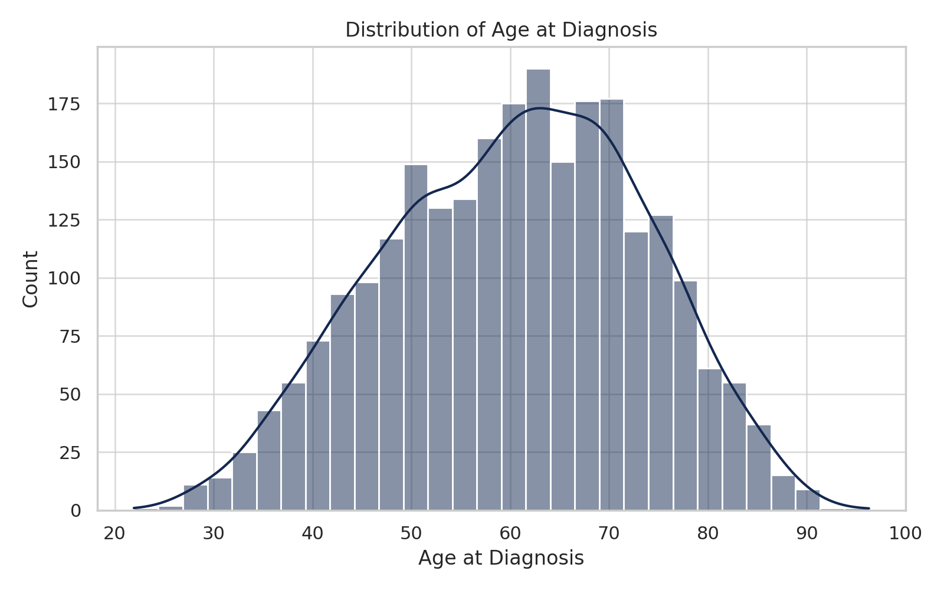
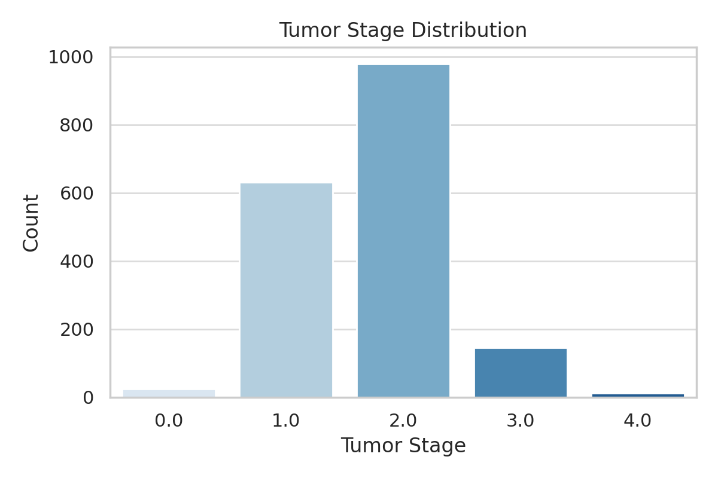
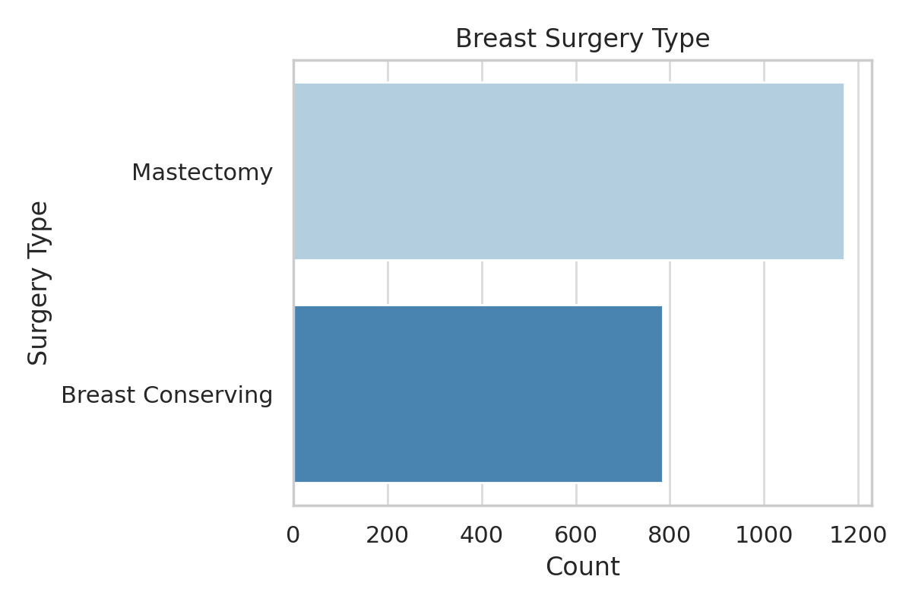
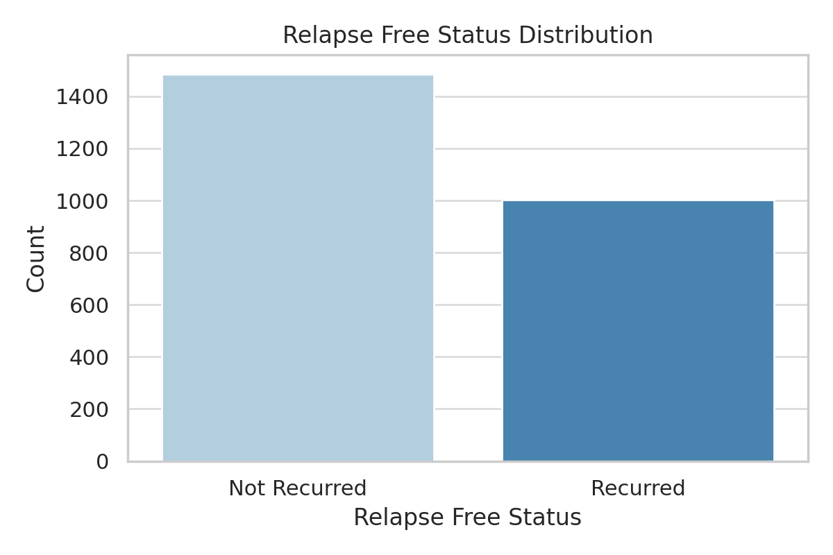
Exploratory Data Analysis
Age at Diagnosis Distribution: The majority of patients were diagnosed between ages 50–70..
Tumor Stage Distribution: Most cases fall under Stage 2, indicating moderate advancement at diagnosis..
Breast Surgery Type: Mastectomy was the more common type of breast surgery compared to breast-conserving procedures.
Relapse Free Status: The dataset is slightly imbalanced with more cases of non-recurrence.

Slide 10
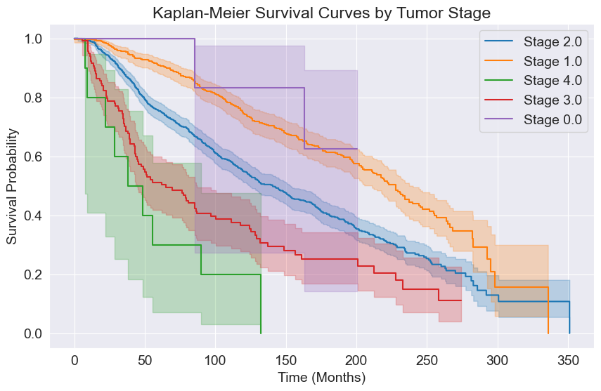
Survival Analysis by Tumor Stage (Kaplan-Meier Curves)
The plot illustrates survival probabilities across different tumor stages.
As expected, patients with earlier stages (e.g., Stage I) show higher survival probabilities over time.
Advanced stages (e.g., Stage III or IV) are associated with significantly lower survival rates and steeper declines in the survival curve.
Highlights the critical impact of tumor stage on long-term survival, emphasizing the importance of early detection and diagnosis.
.

Slide 11
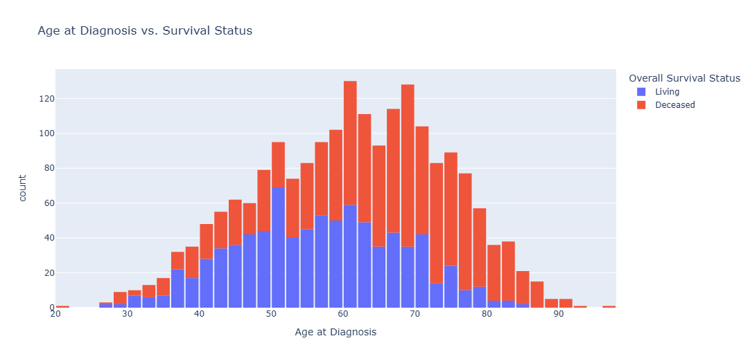
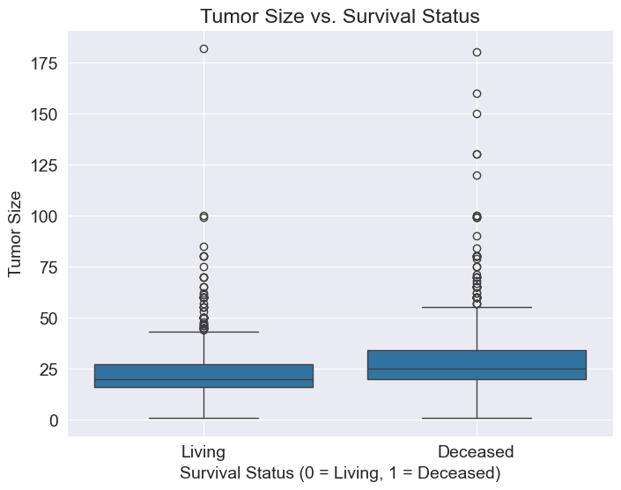
IMPORTANT FEATURES vs TARGET
Tumor Size Distribution by Survival Status:
The boxplot compares tumor sizes between patients who are living vs. deceased.
Patients who are deceased generally have larger tumor sizes, with a higher median and greater spread.
This suggests that larger tumor size may be associated with poorer prognosis and increased mortality.
Supports the clinical relevance of tumor size as a key prognostic indicator in breast cancer outcomes.
Age at Diagnosis vs. Survival Status :
A higher number of deceased patients is observed in the older age groups, particularly above 70 years.
In contrast, younger patients (especially those below 50) show a higher survival rate.
This indicates that age at diagnosis is an important factor, with older age potentially linked to poorer survival outcomes in breast cancer.

Slide 12
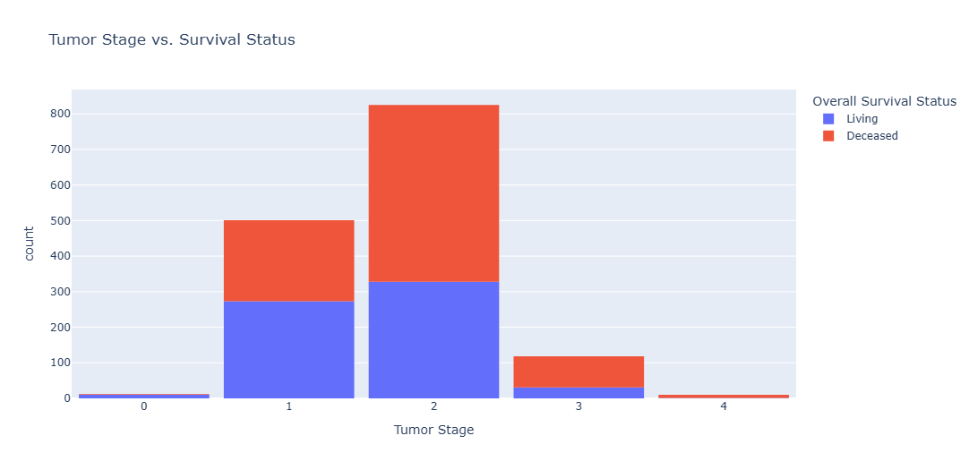
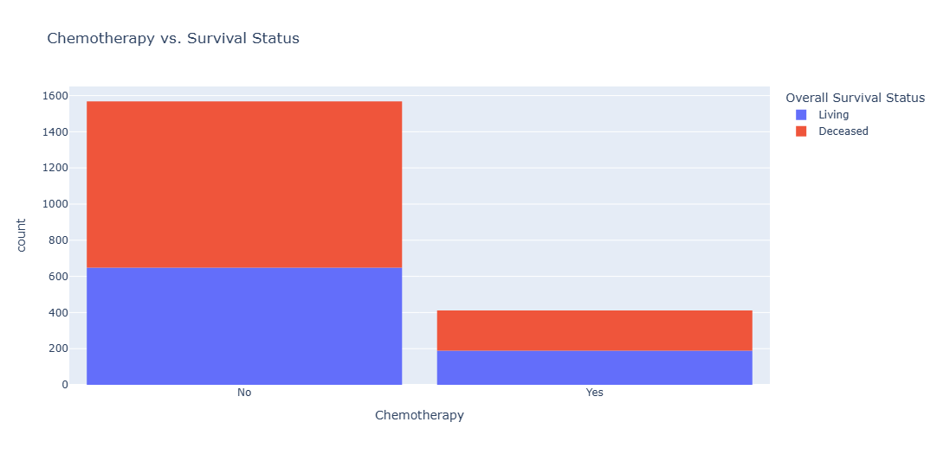
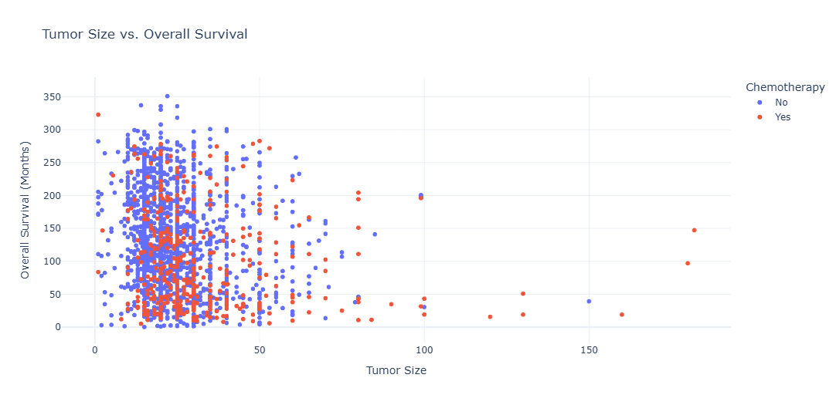
CATEGORICAL FEATURE vs TARGET

Slide 13

PREPROCESSSING
Irrelevant Feature Removal: All features in the dataset appears to be relevant based on EDA. We will retain all the columns, ensuring no valuable information is lost, especially given the dataset’s small size but Removed the following features as they do not contribute meaningfully to the prediction:
Sex: All patients are female, so it provides no variance.
Patient ID: A unique identifier with no predictive power.
Overall Survival Status: Directly related to the target variable, so including it could lead to data leakage.
Missing Value Treatment: Dropped missing values in ‘Overall Survival (Months)’ and ‘Overall Survival Status’ using dropna().
Outliers Treatment: Outliers were not removed because:
Some extreme values might be clinically relevant in breast cancer data.
Tree-based models (like Random Forest) are robust to outliers.
The dataset size is small, and removing outliers could reduce model performance.
Transformations like scaling can help mitigate outlier effects.
Categorical Feature Encoding: Applied one-hot encoding to categorical variables such as Cancer Type, HER2 status, and Hormone Receptor status to convert them into numerical format..
Feature Scaling: Scaling was deferred since some models (like Decision Trees) do not require it.
If needed, scaling will be handled using pipelines during model training.

Slide 14
TRAIN TEST SPLIT
Training, Validation and Test Sets
While building real-world machine learning models, it is quite common to split the dataset into three parts:
Training set - used to train the model, i.e., compute the loss and adjust the model's weights using an optimization technique.
Validation set - used to evaluate the model during training, tune model hyperparameters (optimization technique, regularization etc.), and pick the best version of the model. Picking a good validation set is essential for training models that generalize well.
Test set - used to compare different models or approaches and report the model's final accuracy. For many datasets, test sets are provided separately. The test set should reflect the kind of data the model will encounter in the real-world, as closely as feasible.
SPLITING THE DATA INTO X & Y
We divided the dataset into two parts: X and y.
"X" typically represents the independent Variables, and "y" represents the Dependent (target variable) that we want to predict or understand.

Slide 15
MODEL SELECTION
Models used:
Logistic Regression: logistic Regression is commonly used for binary classification problems. it's preferred because it provides a simple an efficient way to model the relationship between the independent variables and the probability of a certain outcome.
Decision Tree: Decision Tree algorithms are used for classification because they are simple, computationally efficient, and effective in handling high-dimensional data.
Works best for categorical independent columns.
Random Forest Algorithm: Random Forest: Random Forest is a robust supervised algorithm suitable for both regression and classification tasks. It helps predict outcomes by combining the results of multiple decision trees. It's commonly used in applications like predicting house prices, classifying images and analyzing customer behavior

Slide 16


Accuracy
Precision
Recall
F1-Score
%
%
%
%
Understanding
Logistic Regression | 79 | 79 | 80 | 79
Decision Tree | 83 | 80 | 86 | 82
Random Forest Classifier | 86 | 85 | 88 | 86
Precision: The accuracy of the model when it claims to have found something.
Recall: Recall: The ability of a model to find all the relevant cases
F1 Score: A balance between recall and precision, useful when both false positives and false negatives need to be minimized.
Experimental Results :
Random Forest Dominates: Random Forest Classifier excels with 86% accuracy, balanced precision (185%) and recall (88%), showcasing superior overall classification performance.
Percentage (%)
Logistic Regression & Decision Tree Consistency: Both algorithms maintain 79% and 83% accuracy, with Decision Tree having higher precision (80%) and Random Forest higher recall (80%).
Logistic Regression: LR achieves 79% accuracy and high precision (79%) but higher recall (80%).

Slide 17





Conclusion
Conclusion
Key Findings
The results indicated that the Random Forest Classifier model had the highest accuracy of 86%
The study utilized the Kaggle Heart Failure Prediction dataset with 2509 instances, and all algorithms were implemented on Jupyter Notebook
The accuracies of all algorithms were above 79% with the lowest accuracy of 79% given by Logistic Regression and the highest accuracy given Random forest Classifier as previously mentioned.
Limitations
Single and Small Size Dataset Limitation:
The study relies on a single dataset, potentially limiting its generalizability to diverse populations.
Limited Variable Consideration:
The analysis focuses narrowly on demographic and clinical variables, overlooking lifestyle and genetic factors relevant to heart health.
Lack of Test Dataset Evaluation:
The model's performance on new, unseen data is not evaluated, raising concerns about its real-world applicability.
Future research
Future research must ensure robustness, generalizability, and interpretability for informed decision-making based on study findings. It's important to check how duplicate data and unusual values affect the model's accuracy. Creating strategies to deal with these issues is valuable for improving model performance.

Slide 18


